Slide 1
GNSS Localisation (OOP)
Team members -
Pratham Lahoti - 2023A7PS0434G
Varun Bhatt - 2023A7PS0464G
Navya Agarwal - 2023A7PS0359G
Archit Sapra - 2023A7PS0348G

Slide 2
Progress updates
We researched about different types of GNSS Localisation techniques to find which one is best suitable for the rover -
Differential GPS - Enhances GPS accuracy by using ground-based reference stations to correct satellite signal errors
Real Time Kinematic - Provides extremely high precision (down to a few centimeters) by comparing GPS signal patterns between a base station and a moving receiver.
Assisted GPS - Uses cell towers and Wi-Fi networks to speed up location fixing, especially in weak signal areas like cities.
Precise Point Positioning - Offers precise positioning using only a GNSS receiver without nearby reference stations but slower and costly.

Slide 3
We researched on different types of methods to improve GNSS localisation
Kalman Filter - Predicts and corrects GNSS data errors to improve location accuracy by combining noisy data with known positions. EKF handles non-linear movements and provides better results in complex environments
Particle Filter - Estimates locations by simulating multiple possible positions and refining guesses based on new data. More accurate in unpredictable or complex environments but requires more computational power than Kalman filters
Sensor Fusion - Combines data from multiple sensors (GPS, IMU, LiDAR) to improve positioning accuracy, especially in challenging environments like tunnels or dense urban areas.

Slide 4
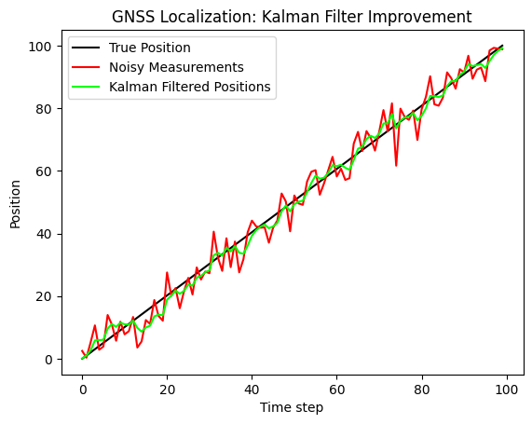
Implementation of kalman filter
Using python libraries such as pykalman, we implemented kalman filter and particle filter to a simulated GNSS scenario where receiver was moving in a straight line with constant velocity. Noise generated was random.
These were the results -

Slide 5
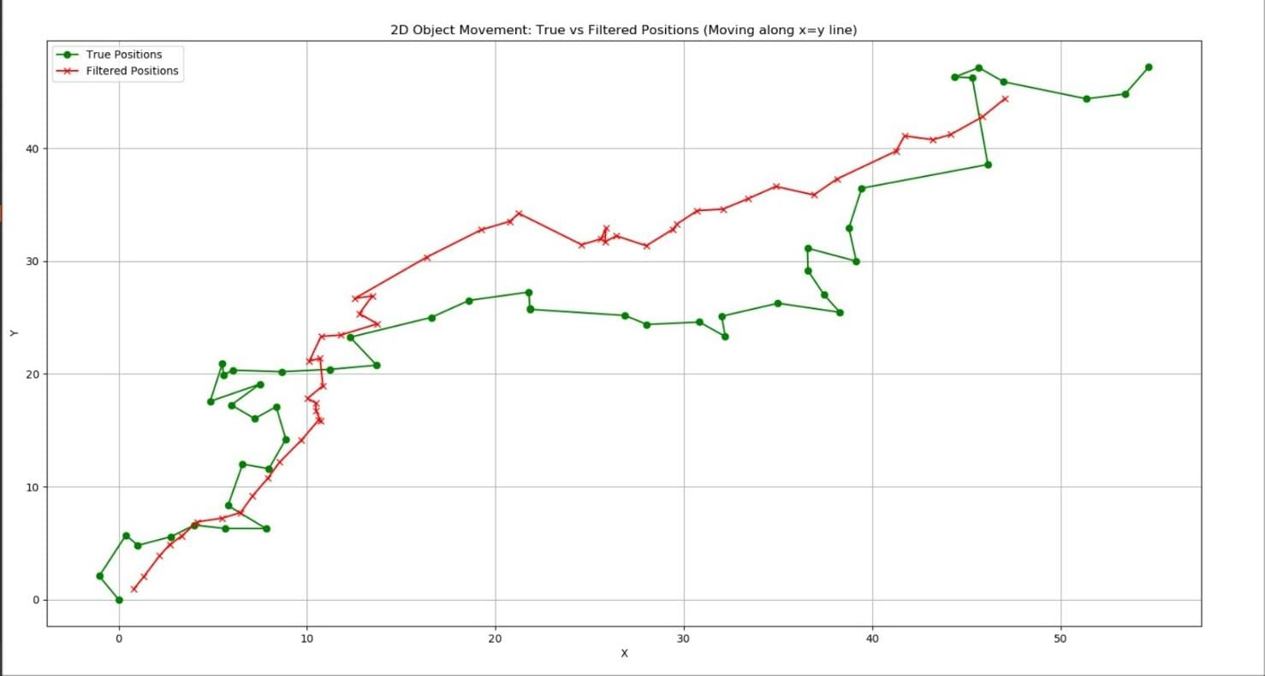
Implementation of particle filter

Slide 6
Target
For our project, we will implement Real-Time Kinematic (RTK) positioning, known for its centimeter-level accuracy, making it ideal for applications like autonomous vehicles, drones, and other precision-dependent systems. RTK provides real-time correction data from a base station, significantly reducing errors caused by atmospheric conditions.
Development Plan:
Rover and Base Station Setup: There are two alternatives for Rover and Base Station Setup
1.The rover ( GNSS receiver) will receive signals from satellites, while the base station (at a known position) sends a correction message to rover and the rover combines the signal received by satellite and correction message to calculate accurate position.
2.GNSS and IMU(Inertial Measurement Unit): GNSS provides global positioning by receiving signals from the satellite. Then the IMU measures the motion continuously. When GNSS and IMU are combined, the system uses GNSS for global accuracy and IMU for continuous, real-time updates, creating a more robust, precise navigation system.

Slide 7
•Code Development: We’ll write code that processes raw GNSS data on the rover. Using
libraries or custom-built algorithms, the rover will apply real-time corrections sent over a
data link (e.g. IMU). The code will manage the flow of corrections and compute precise
positions.
•Testing: We’ll test the system on D side roads in different environments logging the
rover’s coordinates to analyze accuracy and performance.

Slide 8
Current assignment
Our next task is to create a coordinate transformation script which would convert your gps data to global coordinates of gazebo on ROS 2.

